Slide 1

POPULATION GROWTH AND REPRODUCTION
Wedsanley Jean Philippe
STATISTICIAN-DATA SCIENTIST

Slide 2



Demograpic
CONTEXT
12 million today, according to the IHSI, the population could reach 16 million by 2030 and approximately 28 million by 2050.
Economic
The growth rate from 1976 to 2008 is 0.76% while the demographic rate was around 2%. With a GDP per capita of $824, Haiti not only comes last in the ranking of the richest Caribbean territories.
Environmental
Haiti has very few large cities and the structure of these cities is not adapted to a large population. This causes insalubrities and slums.Modern infrastructure is absent in our cities.

Slide 3

Lack of control on fecundity
Problems
In Haiti, there is no birth control.Very often, children are born without any preparation in advance, nothing has been planned.
Early pregnancies
Of every 1,000 girls between the ages of 15 and 19, 66 have had at least one early pregnancy in Haiti, according to a 2012 study commissioned by the Ministry of Public Health and Population (MSPP). This causes young girls to be uneducated and impoverished.

Slide 4




Data Source
44% of women with at least one child reported having at least a child before 20 years.
Of the young women between 15 and 19 years old, 8% are already pregnant or have been pregnant at the time of the survey.
10% are in menopause and have an average of 3.9 children.
In 2016, within the framework of EMMUS 15513 women were questioned about their sexual and reproductive lives. 55.48% of these women reported having given birth to at least one child.

Slide 5
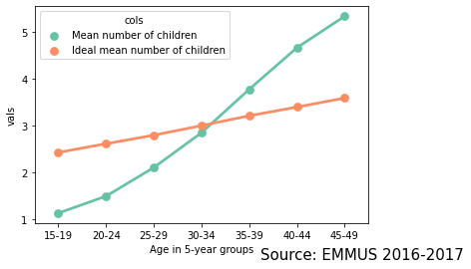

Children born and wanted by age group
In average, women reach their desired number of children in the 30-34 age group

Slide 6
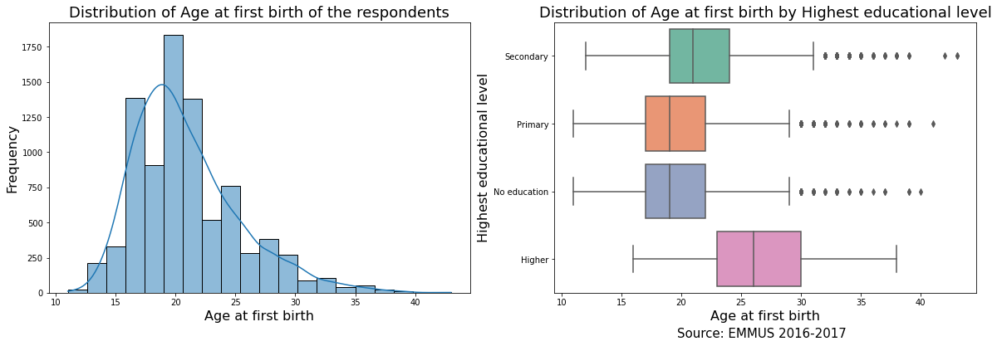
Distribution of the age at first birth
In general, women have their first child at 20 years old.
The less educated they are, the earlier they have their first child.

Slide 7
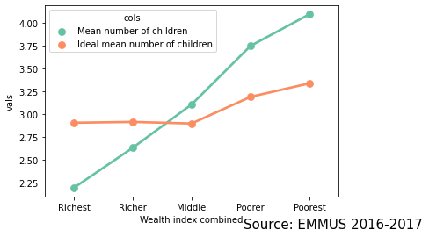
Children born and desired by economic status
The most affluent women have fewer children than they would like, while the poor have more. The middle-class women are approaching the desired number.

Slide 8
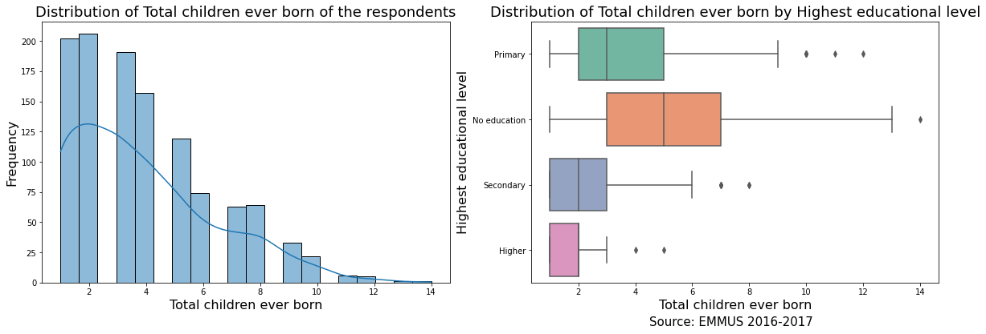
Children born by women in menopause
The average number of children per woman reaching menopause is: 3.91. The more educated women are, the less children they give birth to.

Slide 9
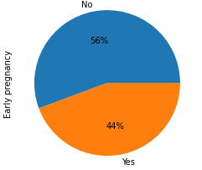
Women giving birth before 20 years old
44% of the women get pregnant before 20 years.

Slide 10
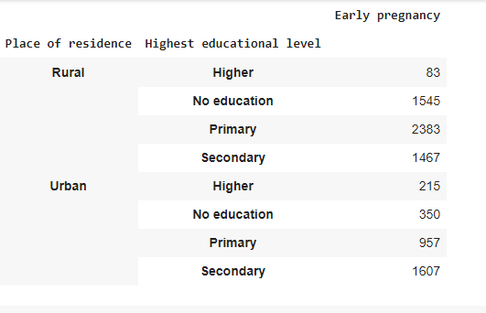
Number of early pregnancies by place of residence and educational level
The majority of early pregnancies are rural and under secondaty level

Slide 11
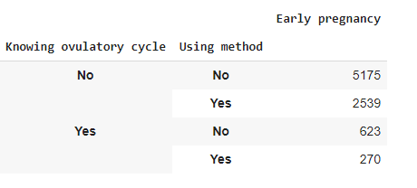
Early pregnancies by biological knowledge and contraceptive methods
Women who get pregnant before the age of 20 are those who have no knowledge of the ovulatory cycle and do not use any contraceptive method.

Slide 12
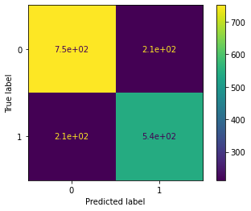
Modeling: Predicting early pregnancy
With a 75% accuracy, here is the confusion matrix
Logistic regression
Early pregnancy depends on the the place of residence, the age at first sex, the educational level, the knowledge of ovulatory cycle and the usage of contraceptive method.

Slide 13


Guidelines
Guideline 1
Education for young girls especially in rural areas. 8% of 15-19 girls that are already mothers, they can reach over 40% if anything is done.
guideline 2
Women's economic empowerment.
When women are in dad economic level and unemployment, the data show that they are most likely to get pregnant before 20 years and have more than 3 children.

Slide 14

Strategic Plan
Step 1
1
Step 2
2
Step 3
3
Step 4
4

Slide 15
Strengh
Weakness
SWOT Analysis
Opportunities
Threats

Slide 16
Contactez-nous
+509 46 36 6494
wedsanleyjp97@gmail.com

